Slide 1
Comprehensive Digital Marketing
Project Work
GROUP MEMBERS :-
HANUSHA VOMBARELLI
M. CHARISHMA
RAJAGIRI THANMAYI
SOHAIB MOHAMMAD
KUMARAPU MUNI

Slide 2
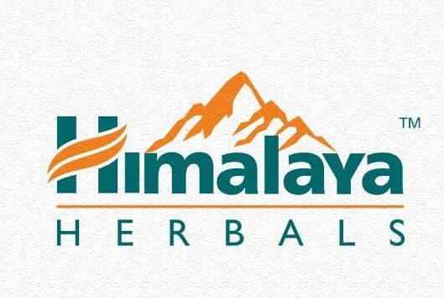

Slide 3
About the Company:-
Himalaya was founded in 1930 by M. Manal with a vision that they want to serve humanity by launching ayurvedic products and to untangle the mystery behind the 5,000-year-old system of medicine. The company started its operations in Dehradun and later spread exponentially. Today, Himalaya is a leading global herbal health and personal care organization with close to 500 products in over 100 countries. They also have a website where one can directly purchase their products. Himalaya products are available on third-party retailing apps and sites as well.

Slide 4

Part 1: Brand study, Competitor Analysis & Buyer’s/Audience’s Persona
Research Brand Identity: Study the brand's mission, values, vision, and unique selling propositions (USPs).
Mission:Himalaya Herbal Products:
“Empowering Lives through Nature's Wisdom"
Himalaya Herbal Products is committed to empowering lives by harnessing the wisdom of nature. We strive to provide the highest quality herbal products that promote health, wellness, and a balanced lifestyle. Our mission is rooted in the belief that nature holds the key to human well-being, and we aim to unlock its potential to enhance the lives of people across the globe.

Slide 5
Vision of Himalaya Herbal Products:
"To be the Global Leader in Herbal Wellness, Transforming Lives with Innovative and Natural Solutions"
Our vision is to become the global leader in herbal wellness, offering a diverse range of innovative and natural solutions for various health and beauty needs. We envision a world where people embrace the power of nature to improve their overall well-being. Through cutting-edge research and development, sustainable practices, and a deep understanding of traditional herbal knowledge, we aspire to be at the forefront of the herbal healthcare industry.
Himalaya Herbal Products seeks to inspire people to adopt a holistic approach to health, connecting with nature's bounty while respecting the environment. We aim to touch the lives of millions worldwide, helping them lead healthier and happier lives through our products and initiatives. Our commitment to social responsibility and ethical practices is integral to our vision, as we Endeavour to make a positive impact on the communities we serve.
Through our mission and vision, we aim to foster a sense of trust and reliability among our customers, partners, and stakeholders, reaffirming our dedication to offering herbal products that are safe, effective, and sustainable.

Slide 6
Unique Selling Points (USPs) of Himalaya Herbal Products:
Natural Ingredients: Himalaya Herbal Products are crafted using carefully selected natural ingredients sourced from pristine environments. The company's commitment to using authentic and pure herbal extracts sets its products apart, ensuring efficacy and safety.
Herbal Tradition: With a legacy spanning over eight decades, Himalaya has deep-rooted expertise in Ayurveda and herbal medicine. Their formulations are based on ancient wisdom, backed by modern research and scientific validation.
Scientific Research: Himalaya invests heavily in research and development to create innovative herbal solutions. Their team of experts collaborates with scientific institutions, ensuring that each product is supported by evidence-based research.
Quality Assurance: The company maintains stringent quality control measures throughout the manufacturing process. Himalaya products undergo rigorous testing to meet international quality standards, ensuring consistency and reliability.
Range of Offerings: Himalaya offers a diverse range of products catering to various health and beauty needs. From herbal supplements and skincare to personal care and baby care products, Himalaya provides comprehensive solutions for the whole family.

Slide 7
Part 1: Brand study, Competitor Analysis & Buyer’s/Audience’s Persona
Analyze Brand Messaging:
Introduction:
Himalaya Herbal Products is a renowned brand in the herbal wellness industry, known for its commitment to providing natural and safe solutions for health and beauty needs. Analyzing the brand messaging reveals a compelling narrative that revolves around the power of nature, ancient Ayurvedic wisdom, and a dedication to promoting holistic well-being.
1. Nature's Wisdom and Ayurvedic Heritage:
The brand messaging of Himalaya Herbal Products consistently emphasises the value of nature's wisdom and the brand's deep-rooted Ayurvedic heritage. This positioning highlights their use of carefully selected natural ingredients sourced from pristine environments, which sets their products apart in the market.
2. Scientific Validation and Research-Backed Formulations:
A key aspect of the brand messaging is the integration of ancient Ayurvedic knowledge with modern scientific research. Himalaya Herbal Products highlights its investment in research and development, ensuring that each product is backed by evidence-based studies, reinforcing consumer confidence in the efficacy and safety of their offerings.

Slide 8
3. Trust and Reliability: The brand messaging portrays Himalaya as a trusted and reliable name in the herbal wellness industry. With a legacy spanning over eight decades, the brand's commitment to quality, consistency, and customer satisfaction resonates with consumers, creating a strong sense of trust in the brand.
4. Diverse Product Range: Himalaya's brand messaging underscores the company's diverse range of offerings, catering to various health and beauty needs. From herbal supplements and skincare to personal care and baby care products, the brand showcases its ability to address a wide array of consumer requirements.
5. Global Reach and Accessibility : The brand messaging highlights Himalaya Herbal Products' global presence and extensive distribution network, making their herbal solutions accessible to a broad international audience. This emphasis on global reach strengthens their position as a prominent player in the herbal wellness market.

Slide 9
• Examine the brand's tagline:
'Khush Raho, Khushaal Raho' bringing to life its vision of “Wellness in Every Home, Happiness in Every Heart”.
Himalaya Herbal Products, with its tagline 'Khush Raho, Khushaal Raho,' brings to life its vision of "Wellness in Every Home, Happiness in Every Heart." The tagline effectively encapsulates the brand's core values and mission, highlighting its commitment to enhancing the well-being of individuals and communities alike.
"Khush Raho, Khushaal Raho" translates to "Stay Happy, Stay Prosperous" in English, and it reflects Himalaya's primary goal of promoting a healthy and fulfilling lifestyle for everyone. The use of the vernacular language in the tagline adds a touch of warmth and familiarity, resonating with diverse cultural backgrounds and reaching out to a wide audience.
The tagline brilliantly articulates the brand's vision of "Wellness in Every Home." Himalaya envisions its herbal products as an integral part of every household, where they contribute to the well-being of individuals and families alike. By emphasizing the idea of "Wellness in Every Home," the brand aims to create a positive impact on society, promoting healthier lifestyles and preventive healthcare practices.

Slide 10
Furthermore, the tagline reinforces the concept of "Happiness in Every Heart," reflecting the emotional aspect of Himalaya's products. The brand understands that true wellness goes beyond physical health and extends to emotional well-being. By fostering happiness and contentment, Himalaya aims to improve the overall quality of life for its consumers, promoting a sense of inner joy and harmony.
In summary, the tagline 'Khush Raho, Khushaal Raho' eloquently brings to life Himalaya Herbal Products' vision of "Wellness in Every Home, Happiness in Every Heart." It encapsulates the brand's dedication to offering effective and safe herbal solutions that enrich lives and promote a state of well-being for individuals and communities. Through its holistic approach to health and happiness, Himalaya seeks to be a trusted companion in every home, touching hearts and inspiring a healthier and happier world.

Slide 11
Part 1: Brand study, Competitor Analysis & Buyer’s/Audience’s Persona
Competitor Analysis: Select three competitors operating in the same industry or niche as the chosen brand, examine their USPs and online communication.
Competitor 1:PATANJALI
https://www.patanjaliayurved.net/
Competitor 2: HUL(Hindustan Unilever Limited )
https://www.hul.co.in/
Competitor 3:DABUR
https://www.daburshop.com

Slide 12

PATANJALI :
Patanjali products are a range of consumer goods and wellness items manufactured by Patanjali Ayurved Limited, an Indian multinational company founded by Baba Ramdev and Acharya Balkrishna. Established with the aim of promoting Ayurvedic principles and natural remedies, Patanjali has gained significant popularity in India and abroad.
Patanjali's product line includes a wide array of items, such as food products, herbal supplements, personal care products, and home care solutions. These products are based on Ayurvedic principles, which emphasize using natural ingredients and traditional remedies to promote overall well-being.
For personal care, Patanjali offers a vast assortment of herbal cosmetics, skincare, and haircare products. These include shampoos, soaps, face washes, toothpaste, and creams, all formulated with natural ingredients to enhance their appeal to health-conscious consumers.
The company also provides herbal supplements and medicines for various health concerns, such as immunity boosters, digestive aids, and remedies for specific ailments. These products are developed using traditional Ayurvedic formulations.

Slide 13
PATANJALI PRODUCTS USP :
Patanjali products' unique selling proposition (USP) lies in their strong foundation in Ayurveda, the use of natural ingredients, and their commitment to offering affordable wellness solutions. As a brand, Patanjali has managed to capture the attention of consumers in India and beyond with its distinctive approach to consumer goods and wellness products.
Ayurvedic Heritage: Patanjali's USP centers around its deep-rooted connection with Ayurveda, the ancient Indian system of medicine. The brand promotes the wisdom of Ayurvedic principles, which emphasize holistic well-being and natural healing through the use of herbs, plants, and traditional remedies.
Natural Ingredients: A key element of Patanjali's USP is its focus on using natural ingredients in the formulation of its products. By avoiding harmful chemicals and artificial additives, the brand appeals to health-conscious consumers seeking products that are gentle on their bodies and the environment
Holistic Wellness Solutions: Patanjali offers a diverse range of products spanning various categories, including food, personal care, healthcare, and home care. This comprehensive approach to wellness makes it a one-stop destination for consumers looking to adopt a holistic lifestyle.

Slide 14

HUL(Hindustan Unilever Limited ):
Hindustan Unilever Limited (HUL) offers a diverse range of herbal products that prioritize natural ingredients and traditional remedies inspired by Ayurveda. With a commitment to safety, effectiveness, and eco-friendly practices, HUL's herbal products cater to health-conscious consumers seeking holistic wellness solutions. The brand's trusted reputation, extensive research and development, and consumer-centric approach have positioned HUL as a leader in the herbal and Ayurvedic segment, providing customers with a wide array of skincare, hair care, personal care, and home care products that promote overall well-being and enhance their natural beauty.
HUL Herbal Products offer a wide range of natural, safe, and effective solutions for consumers seeking wellness and beauty products inspired by Ayurveda and traditional herbal remedies. As a trusted brand in India, Hindustan Unilever Limited (HUL) has capitalized on the growing demand for herbal and Ayurvedic products, delivering a comprehensive portfolio that includes skincare, hair care, personal care, and home care items. With a strong emphasis on natural ingredients, extensive research, and a consumer-centric approach, HUL's herbal products cater to health-conscious individuals looking for reliable and eco-friendly solutions to enhance their overall well-being.

Slide 15
HUL PRODUCTS USP :Natural, Safe, and Effective
Natural Ingredients: Hindustan Unilever Limited (HUL) stands out for its emphasis on using natural and herbal ingredients in its herbal products. By steering clear of harsh chemicals and synthetic additives, HUL ensures that its offerings are gentle on the skin and hair, appealing to health-conscious consumers seeking safer alternatives.
Ayurvedic Heritage: Rooted in the principles of Ayurveda, HUL's herbal products draw inspiration from the ancient Indian system of medicine. This association adds a sense of traditional wisdom to the brand, resonating with consumers who appreciate time-tested remedies.
Extensive Research and Development: HUL invests in rigorous research and development, combining modern scientific advancements with traditional knowledge to create effective herbal formulations. This approach ensures that the products are not only herbal but also scientifically proven to deliver the desired results.

Slide 16
Consumer-Centric Approach : Understanding and addressing the unique needs of consumers is at the core of HUL's herbal products. By continually innovating and adapting to changing preferences, the brand ensures that its herbal offerings remain relevant and effective.
In conclusion: HUL's herbal products' USP lies in their use of natural ingredients, connection to Ayurveda, extensive research and development, trusted brand reputation, diverse product range, eco-friendly initiatives, and consumer-centric approach. By incorporating these elements, HUL has successfully positioned itself as a leading provider of natural, safe, and effective herbal solutions, catering to the growing demand for health and wellness products.

Slide 17

DABUR :
Dabur Herbal Products is a renowned brand known for its wide range of natural and Ayurvedic products that promote health, wellness, and beauty. With a legacy of over a century, Dabur has established itself as a trusted name in the herbal industry, offering a variety of herbal remedies and solutions for consumers seeking natural alternatives.
Dabur Chyawanprash : A well-known herbal health supplement, Chyawanprash is made from a combination of Ayurvedic herbs and is believed to boost immunity and overall health.
Dabur Honey: Pure and natural, Dabur Honey is sourced from the finest flowers and is known for its numerous health benefits, including aiding digestion and providing natural energy.
Dabur Amla Hair Oil: Enriched with the goodness of Amla (Indian Gooseberry), this hair oil is designed to promote hair growth, prevent hair fall, and improve hair health.

Slide 18
DABUR USP :
Heritage of Herbal Wisdom: Dabur's USP lies in its rich heritage of herbal wisdom that dates back to 1884. The brand draws inspiration from Ayurveda, India's ancient system of medicine, to develop products that harness the healing properties of herbs and natural ingredients.
Natural Ingredients Sourced from Nature: At the core of Dabur's USP is its unwavering commitment to using natural ingredients sourced from nature. With a focus on purity and authenticity, Dabur ensures that its herbal products are free from harmful chemicals, providing consumers with safe and effective solutions.
Traditional Knowledge Backed by Modern Research: Dabur bridges the gap between traditional knowledge and modern research. By combining time-tested Ayurvedic principles with cutting-edge scientific advancements, the brand formulates products that are not only deeply rooted in tradition but also backed by scientific evidence.
Diverse Product Portfolio: Dabur's USP is further bolstered by its diverse product portfolio, catering to various aspects of health, personal care, and wellness. From hair oils and toothpaste to digestive remedies and skincare, Dabur offers a holistic range of herbal solutions for everyday needs.

Slide 19
Part 1: Brand study, Competitor Analysis & Buyer’s/Audience’s Persona
As we just discussed, Himalaya neem face wash targets consumers who suffer from skin problems and acne, particularly the youth, people between the age group of 15 – 25 since they fall under this criteria.
Variety of Products Purchased by the Respondents in Himalaya Face wash S.No Variety of Products No. of Respondents Percentage (%) 1 Purifying neem face wash 22 20.0 2 Clear complexion whitening face wash 11 10.0 3 Gentle exfoliating daily face wash 43 39.1 4 Gentle hydrating face wash 8 7.3 5 Gentle refreshing face wash 10 9.1 6 Neem foaming face wash 16 14.5 7 Total 110 100.0

Slide 20
Since Himalaya is an Ayurveda company, they also focus on people who still have faith in the age-old Ayurveda methods. This is because the practice of Ayurveda is met with a lot of flak in today’s times, being a potential factor in driving away customers. Targeting those who actively prefer it is definitely a good approach.
Positioning: Himalaya face wash positions itself as an Ayurveda, chemical-free face wash that provides to the masses. The brand focuses on all types of consumers, urban and rural alike, and this reflects in its positioning and advertising. They ensure this messaging is turned into sales by way of their widespread distribution network, ensuring accessibility.
Clearly, the brand has been able to stand out amongst its segment and create a varied consumer base. But that is not without the threat of competitors. Let’s take a closer look at them.

Slide 21
Audience of Himalaya Face Wash: Himalaya’s neem face wash has various competitors, old established products as well as new entrants. We shall talk about some of their major competitors.
Neutrogena: Neutrogena’s deep clean facial cleanser and oil-free acne face wash are competitors to the neem face wash as they’re in the same product category, and marketed to similar consumers. Neutrogena also claims to have anti-acne and blackhead properties. Its target market is young adults who are conscious of personal skincare.
Clean & Clear: Clean & Clear’s foaming face wash is an extremely popular consumer pick in India and is also quite affordable. The company mainly markets towards working professionals and college students and has positioned itself as a quality product dealing with facial oil and dirt. Their ads directed towards college-going girls are known to be popular and relatable.
Lotus Herbals: The anti-acne oil control face wash by Lotus is a close alternative to Himalaya’s as they’re both in the herbal space. It also joins Himalaya in most top face wash lists. But the neem face wash generally always ranks higher according to customer reviews and feedback

Slide 22
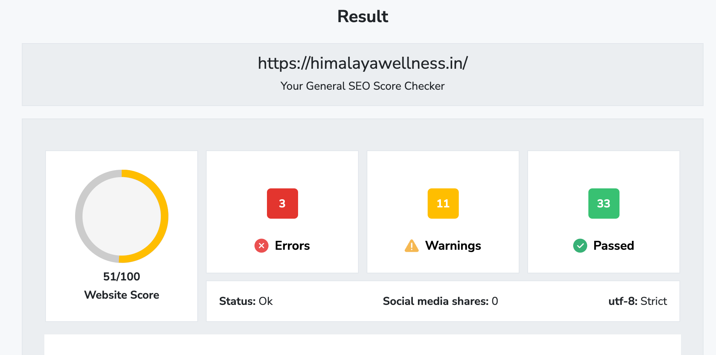
Part 2: SEO & Keyword Research SEO Audit for https://himalayawellness.in/

Slide 23
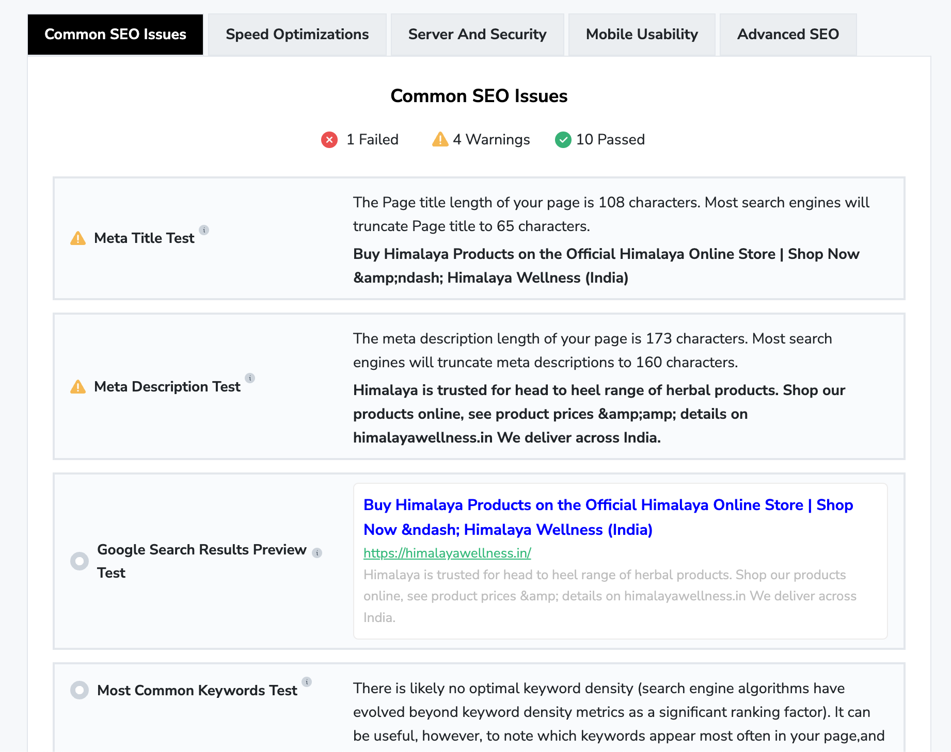

Slide 24
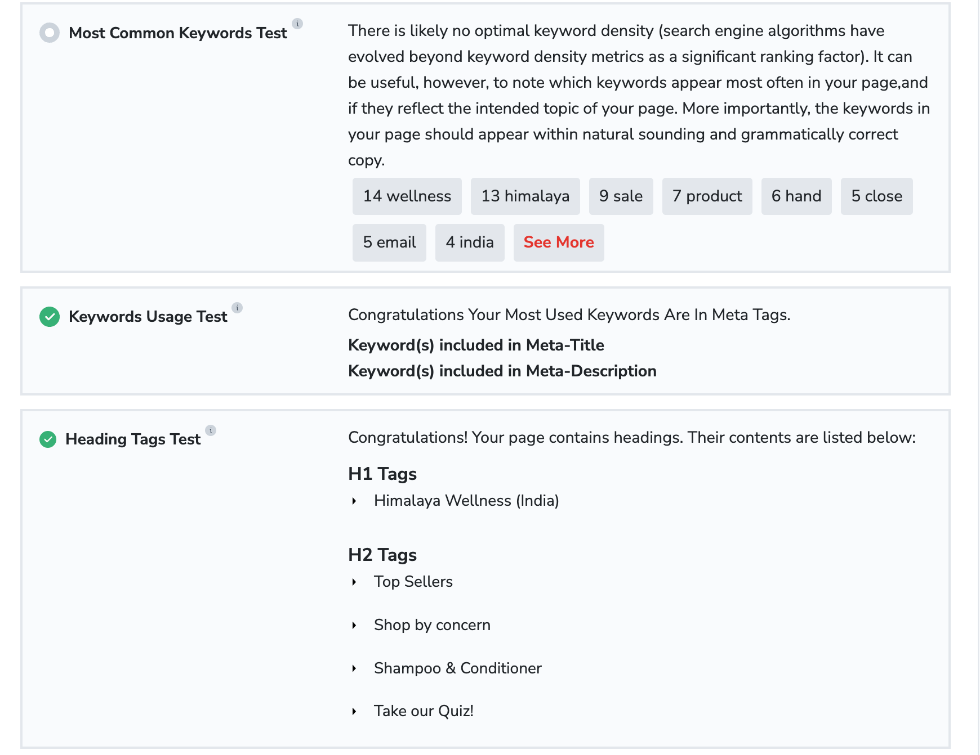

Slide 25


Slide 26


Slide 27


Slide 28


Slide 29


Slide 30


Slide 31


Slide 32


Slide 33
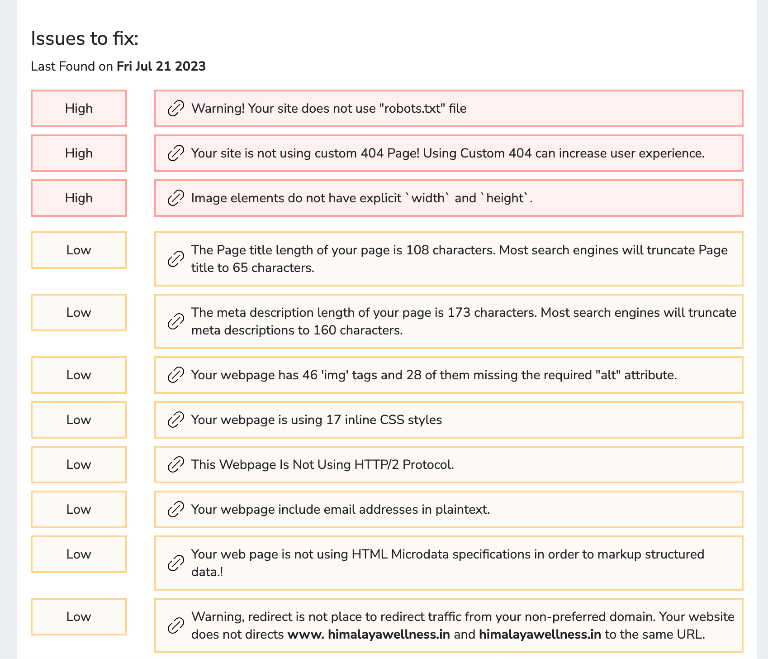

Slide 34
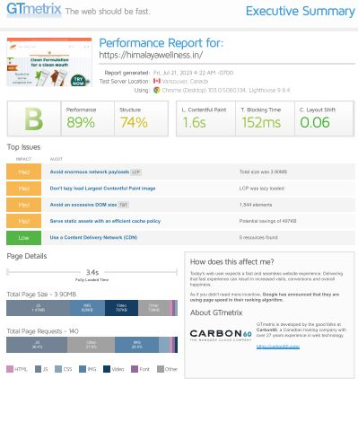


Slide 35


Slide 36
IMPACT | AUDIT
Med | Avoid enormous network payloads LCP | Total size was 3.90MB
Med | Don't lazy load Largest Contentful Paint image | LCP was lazy loaded
Med | Avoid an excessive DOM size TBT | 1,544 elements
Med | Serve static assets with an efficient cache policy | Potential savings of 497KB
Low | Use a Content Delivery Network (CDN) | 5 resources found
Low | Use passive listeners to improve scrolling performance | 1 event listener not passive
Low | Properly size images | Potential savings of 261KB

Slide 37
IMPACT | AUDIT
Low | Reduce unused JavaScript LCP | Potential savings of 720KB
Low | Enable text compression FCP LCP | Potential savings of 39.8KB
Low | Avoid long main-thread tasks TBT | 7 long tasks found
Low | Reduce JavaScript execution time TBT | 874ms spent executing JavaScript
Low | Reduce unused CSS FCP LCP | Potential savings of 11.7KB
Low | Avoid large layout shifts CLS | 5 elements found
Low | Minify JavaScript FCP LCP | Potential savings of 21.6KB

Slide 38
Local SEO: If Himalaya Herbals has physical stores or distribution centers in specific locations, implementing local SEO strategies can help improve visibility in local search results.
Technical SEO: Regularly auditing and optimizing the website's technical aspects, such as page load speed, sitemap, robots.txt, and schema markup, can enhance the website's overall performance in search engines.
It's important to note that since the SEO landscape is dynamic and search engine algorithms are continually evolving, the SEO strategies for Himalaya Herbals' website might have changed or been updated since my last update. Therefore, for the most accurate and up-to-date analysis, it's best to consult with an experienced SEO professional or conduct a fresh SEO audit on the website.

Slide 39
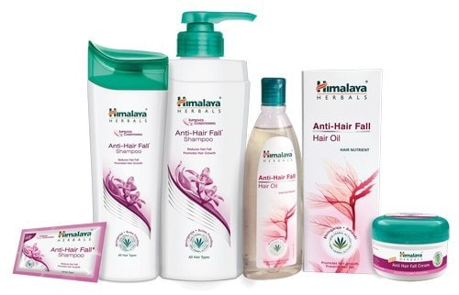
KEYWORD RESEARCH :
I can give you some general insights into how SEO might be applied to a website like Himalaya Herbals:
Keyword Research: An essential part of SEO is identifying relevant keywords that potential customers might use to search for Himalaya Herbals' products. These keywords would include specific product names, health conditions, or terms related to herbal healthcare.

Slide 40

KEYWORD RESEARCH ON HIMAYALAY HERBALS
Here are some keyword research on Himalaya Herbals:
1. Himalaya Herbals
2. Himalaya
3. Herbals
4. Natural remedies
5. Ayurvedic medicine
6. Herbal supplements
7. Ayurvedic supplements
8. Natural health
9. Alternative medicine
10. Himalayan herbs

Slide 41
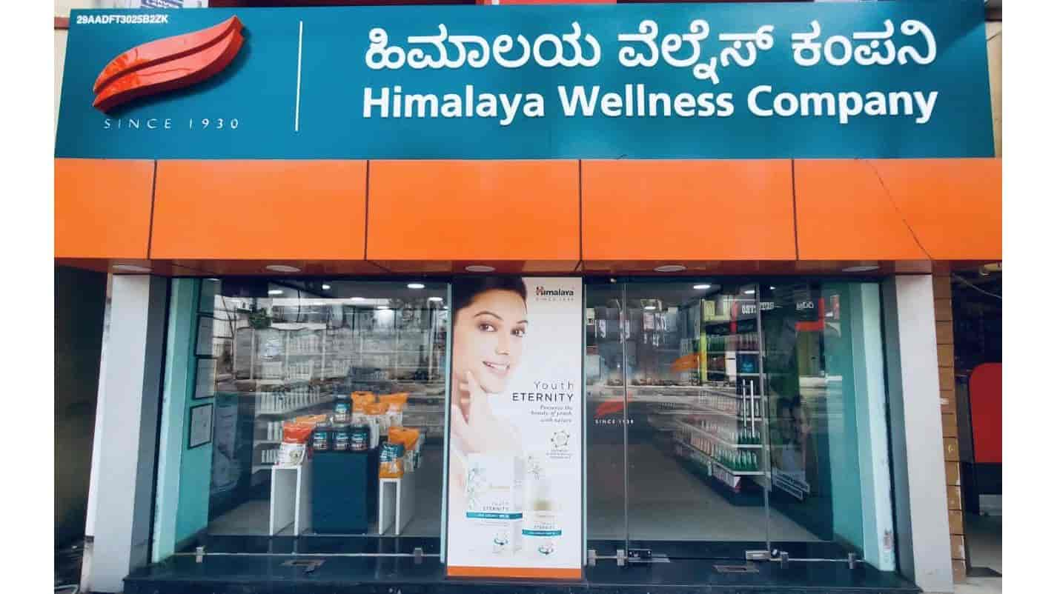
Here are some specific keywords that you can use to target your marketing campaigns:
Himalaya Herbals for hair growth
Himalaya Herbals for weight loss
Himalaya Herbals for skin care
Himalaya Herbals for immunity
Himalaya Herbals for stress relief

Slide 42
On-Page Optimization:
Himalaya Herbals' website should have well-optimized product pages and content that include the identified keywords in meta titles, meta descriptions, headings, and throughout the content in a natural and user-friendly manner.
High-Quality Content: The website should have informative and valuable content related to herbal healthcare, ayurvedic principles, product usage guides, customer reviews, and more. High-quality content can help improve the website's authority and attract more organic traffic.
Mobile-Friendly Design: With an increasing number of users accessing websites from mobile devices, ensuring that the Himalaya Herbals website is mobile-friendly is crucial for better rankings in search engine results.
Backlink Building: Acquiring backlinks from authoritative and relevant websites can help improve the website's search engine rankings. However, it's important to focus on quality over quantity and avoid questionable link-building practices that could lead to penalties from search engines.

Slide 43

Content Calendar

Slide 44
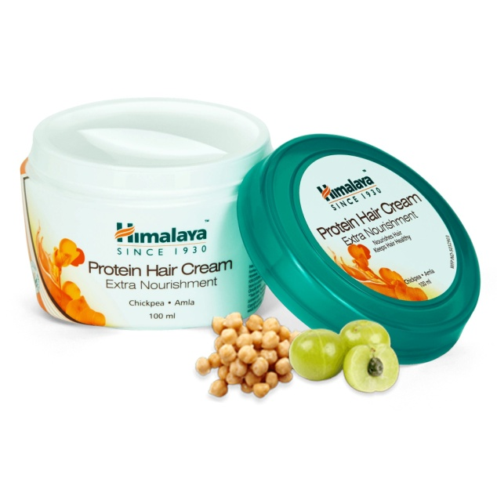
Himalaya Herbals Content Ideas:
Himalaya Herbal is a renowned brand in the dietary supplement industry, known for its high-quality products made from natural ingredients. With a focus on health and wellness, Himalaya Herbal has developed a strong content and strategy to promote its offerings and connect with its target audience.
Their content includes informative blog posts, social media campaigns, and educational videos that highlight the benefits of their products and provide valuable information to consumers. By integrating a holistic approach to well-being and emphasizing the power of nature, Himalaya Herbal has gained a loyal customer base who appreciate their commitment to quality and authenticity.
Himalaya Herbal, known for its range of natural and herbal healthcare products, has been gaining significant attention in recent years. With a strong focus on quality and a commitment to using traditional Ayurvedic principles, Himalaya Herbal has carved a niche for itself in the market. The company's content and strategy have played a crucial role in strengthening its brand identity and attracting a loyal customer base.

Slide 45
Through informative and engaging content, Himalaya Herbal has been able to educate consumers about the benefits of herbal remedies and the importance of taking a holistic approach to health.
In the world of herbal medicine, Himalaya Herbal has made a lasting impact with its unique content and strategy. Their commitment to providing natural and effective products has garnered a loyal following of customers who trust in the brand's quality. With a wide range of herbal supplements, skincare products, and personal care items, Himalaya Herbal has successfully tapped into the growing demand for holistic wellness options. This next paragraph will delve deeper into the brand's key strategies and how they have contributed to its success in the market.

Slide 46

Himalaya Herbals Marketing Strategies:
Now talking about their marketing strategies, Himalaya Herbal's marketing strategy has been instrumental in establishing its presence in the market and attracting a wide customer base. By leveraging digital platforms and social media, the brand has effectively reached out to a larger audience and created a strong online presence.

Slide 47
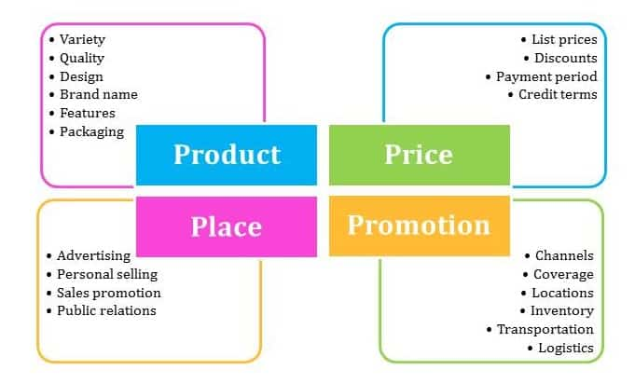
Furthermore, the company's emphasis on educating consumers about the benefits of Ayurvedic principles and herbal remedies has helped build trust and credibility. Through strategic partnerships with influencers and healthcare professionals, Himalaya Herbal has been able to amplify its message and reach potential customers.
With a firm commitment to using traditional
Ayurvedic principles, Himalaya Herbal has
not only established a strong presence in
the market but has also gained a
competitive edge through its effective
marketing strategies.

Slide 48
Market analysis in the Marketing strategy of Himalaya–
Himalaya operates in the market where several companies are offerings similar kind of generic products, the only differentiation is the benefits and the branding that the companies do to make the offerings more acceptable in the market.
Continuously it has been striving & venturing into new segments of the business to lessen its dependency on pharmaceuticals segment and broaden its revenue from personal care, Wellness & nutrition, and other FMCG products.
Customer analysis in the Marketing strategy of Himalaya –
The customer of the company are from all the age groups starting from infants for whom there are baby care products i.e. baby kits & diapers, moms/children/ Old age customers there are wellness and nutritional products, pharmaceuticals products for all age groups of customers, and Personal care products.
Customers of the brand are inclined towards Ayurveda and products which don’t have side effects use the products of Himalaya as it is safe and efficacious.

Slide 49
Challenges:
Competitive Market: The herbal and natural products market is highly competitive, with numerous brands offering similar products. Standing out and establishing a unique identity in such a crowded space can be challenging.
Scientific Validation: In the health and wellness industry, consumers often seek scientific validation of product claims. Himalaya Herbals may face challenges in providing robust scientific evidence to support the efficacy of its herbal formulations.
Quality Control: Maintaining consistent quality across a wide range of herbal products can be complex. Ensuring that all products meet high-quality standards is crucial to building and retaining consumer trust.
Sustainability and Sourcing: Sourcing herbs sustainably can be a challenge to maintain ecological balance. It is essential for the brand to be transparent about its sourcing practices and environmental impact.

Slide 50
Cultural Adaptation: Himalaya Herbals operates in various countries with diverse cultures and preferences. Adapting products and marketing strategies to suit different markets requires careful consideration.
Regulatory Compliance: Adhering to the regulations and standards of different countries can be daunting, especially when dealing with herbal and health products with varying rules across regions.
Consumer Education: Educating consumers about the benefits of herbal products, the brand's values, and the importance of natural ingredients requires continuous effort.

Slide 51
Lessons Learned:
Transparency and Trust: Building a transparent relationship with consumers fosters trust. Sharing information about product ingredients, sourcing, and quality assurance can enhance brand credibility.
Research and Innovation: Investing in research to validate product claims and continuous innovation can help the brand stay ahead of the competition and meet evolving consumer needs.
Social and Environmental Responsibility: Demonstrating commitment to social and environmental causes can resonate with conscious consumers and strengthen brand loyalty.
Localization: Tailoring products and marketing efforts to suit different cultures and preferences can enhance brand relevance in various markets.

Slide 52
Customer Feedback: Listening to customer feedback and addressing their concerns promptly can lead to improvements in products and services.
Digital Marketing and Engagement: Embracing digital platforms to reach and engage with consumers can significantly impact brand visibility and customer loyalty.
Advocacy and Thought Leadership: Positioning Himalaya Herbals as a thought leader in the herbal and natural products industry can enhance credibility and attract a loyal customer base.
While these challenges and lessons are common for companies in the health and wellness industry, Himalaya Herbals' specific experiences and strategies may differ. The brand's journey likely involves continuous adaptation, learning from consumer feedback, and staying true to its core values of promoting herbal solutions for well-being.

Slide 53
Part 4: Content Creation and Curation (Post creations, Designs/Video Editing, Ad Campaigns over Social Media and Email Ideation and Creation)
Post Creation:
Select Content Categories: Identify three different content formats relevant to the chosen topic or industry. Research and Brainstorm: Research trending topics, industry news, or audience interests within each category. Brainstorm ideas for social media posts that align with each category. Do note that 1 content format has to be video and additionally 3 stories/status are to be created.
Format 1: Blog article
Format 2: Video
Format 3: Creative

Slide 54
Himalaya herbals popular products for skin care
Blog article Date:- 12-08-2023
AIM:- To promote skin care products
Himalaya is trusted for head to heel range of herbal products. Shop our products online, see product prices & details on Himalaya wellness.
Himalaya Herbal Healthcare has a very wide range of products, which include "pharmaceuticals, personal care, baby care, well-being, nutrition and animal health products. The company has more than 290 researchers that utilize Ayurvedic herbs and minerals.
Himalaya Neem face wash brand is reportedly the second biggest in India.Mother care products were launched in 2016.

Slide 55
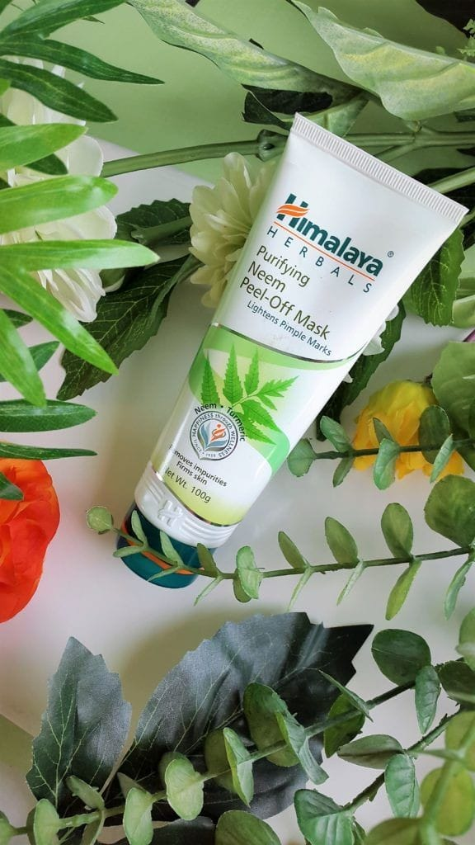
Top 5 Products From Himalaya for skin care :
1. Purifying Neem Peel-Off Mask:
This mask reduces oiliness, helps prevent pimples and lightens pimple marks, leaving you with clear and healthy skin .
It improves general skin health and immunity, combating bacterial infections such as acne, boils and ulcers
Tackles bacteria from the root and prevents the recurrence of pimples and blemishes
It has antiseptic and strong anti inflammatory properties which soothe skin gently, making skin soft and supple.

Slide 56
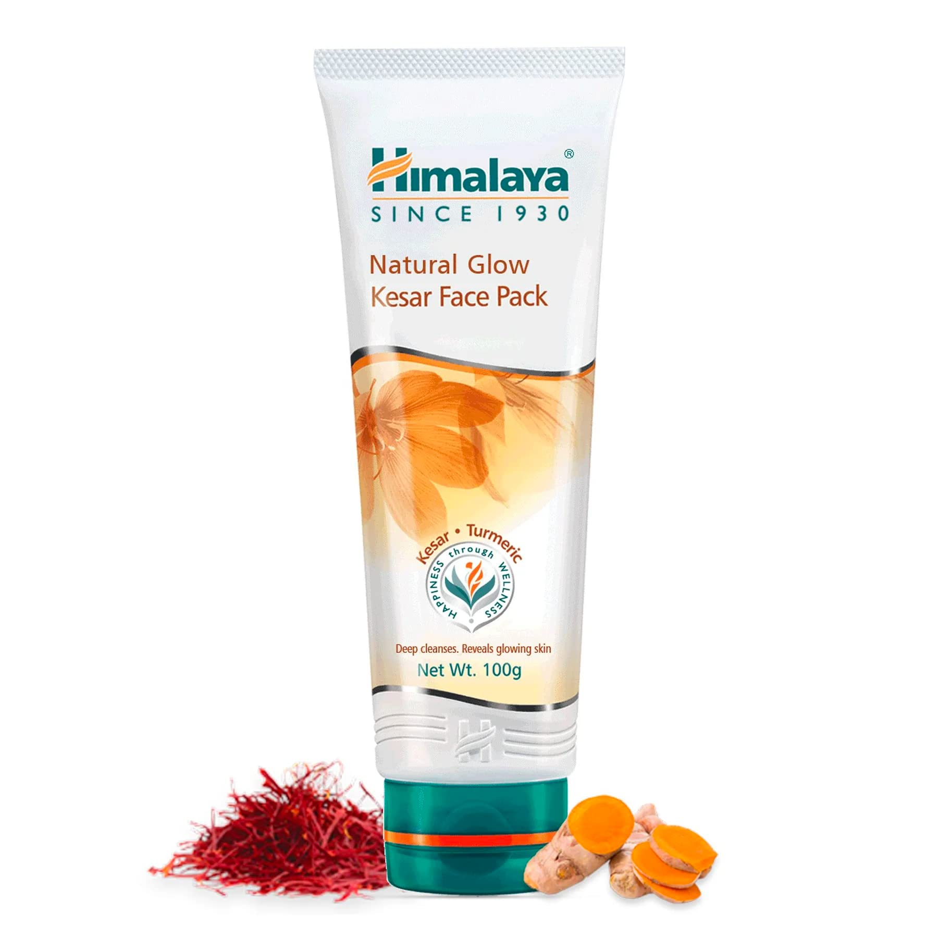
2. Himalaya Fairness Kesar Face Pack:
Himalaya's Natural Glow Kesar Face Pack is a unique natural formulation that evens out skin tone for a glowing you! With the goodness of Turmeric, Walnut, Indian Aloe, and Kesar, it rejuvenates and cleanses your skins off impurities, to reveal a natural glow.
Kesar reported to lighten skin, enhances the complexion, and gives skin an even tone.
Turmeric is known for its anti-inflammatory properties, helps soothe your skin gently.
Walnut is known to possess an abrasive property that helps remove dead skin cells and tone the skin.

Slide 57
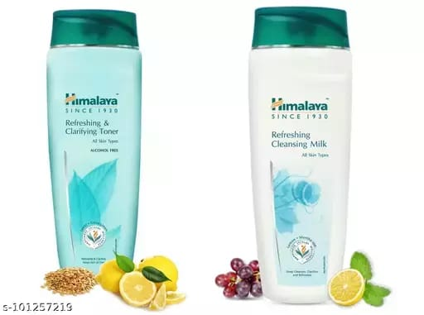
3.Himalaya Refreshing Cleansing Milk:
Himalaya's Refreshing Cleansing Milk contains a special blend of herbs that gently remove dirt, makeup and daily impurities while maintaining your skin's natural moisture balance.
Lemon, a natural cleanser and astringent, clarifies and refreshes, while Grape Seed rejuvenates, and Mint cools your skin to keep it clear, healthy and radiant

Slide 58
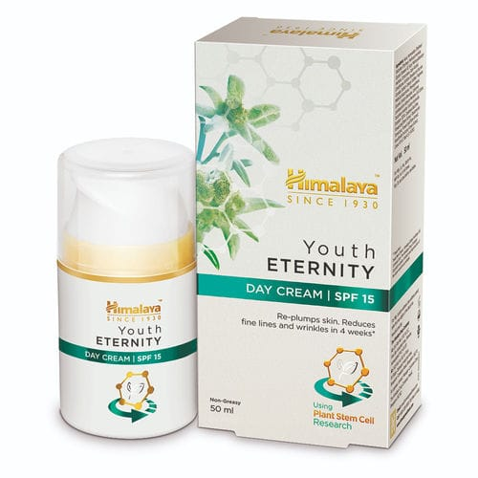
4.Himalaya Youth Eternity Day Cream:
Enriched with the goodness of rare Edelweiss flower that blooms in mountains of Swiss Alps & is known for its anti-oxidants & anti-inflammatory properties
Made with a unique stem-cell technology that helps to regenerate the skin & protects the skin barrier to fight early signs of ageing
Deeply moisturizes the skin and gives an enhanced skin radiance
Visibly reduces fine lines, wrinkles, age spots & pigmentation in 4 weeks
Improves skin texture & elasticity to help reduce sagging and visible pores.
Contains anti-oxidant polyphenols that prevent daily damage caused by sun exposure also called photo-aging
Quick absorbing light-weight formulation with a velvety smooth .

Slide 59
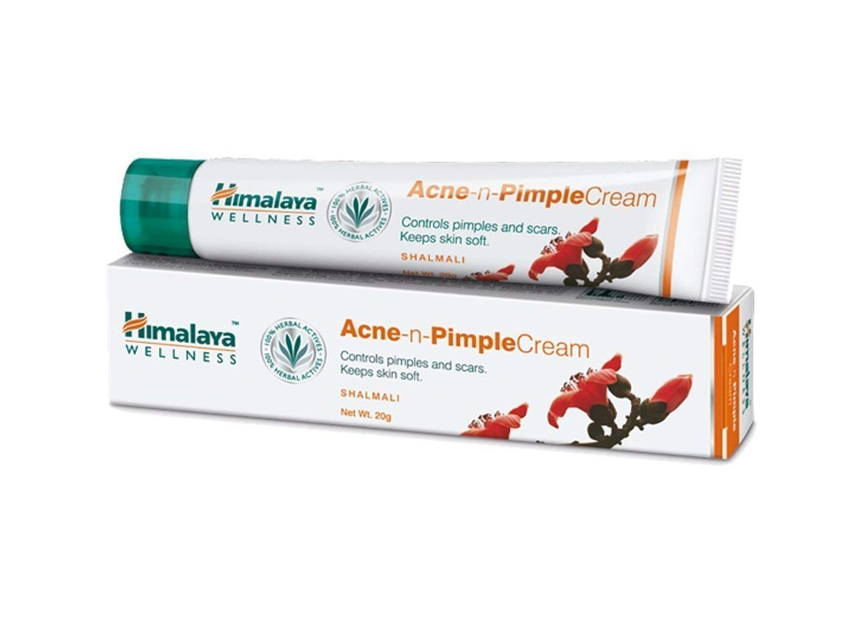
5.Himalaya Acne n Pimple Cream:
Effectively controls pimples and treats various skin eruptions.
The unique herbal blend helps reduce skin inflammation, infection, etc.
Power-packed with stringent, styptic, antimicrobial, and cooling properties.
Includes the moisturizing & healing effect of Aloe Vera.
Also contains Silk Cotton Tree that is loaded with astringent and antibacterial properties that are good for reducing acne.

Slide 60

VIDEO
DATE:- 07-08-2023
AIM :- To spread awareness about the company and products under it .
https://www.instagram.com/reel/CvRQ2yqvoCs/?utm_source=ig_web_copy_link&igshid=MzRlODBiNWFlZA==

Slide 61
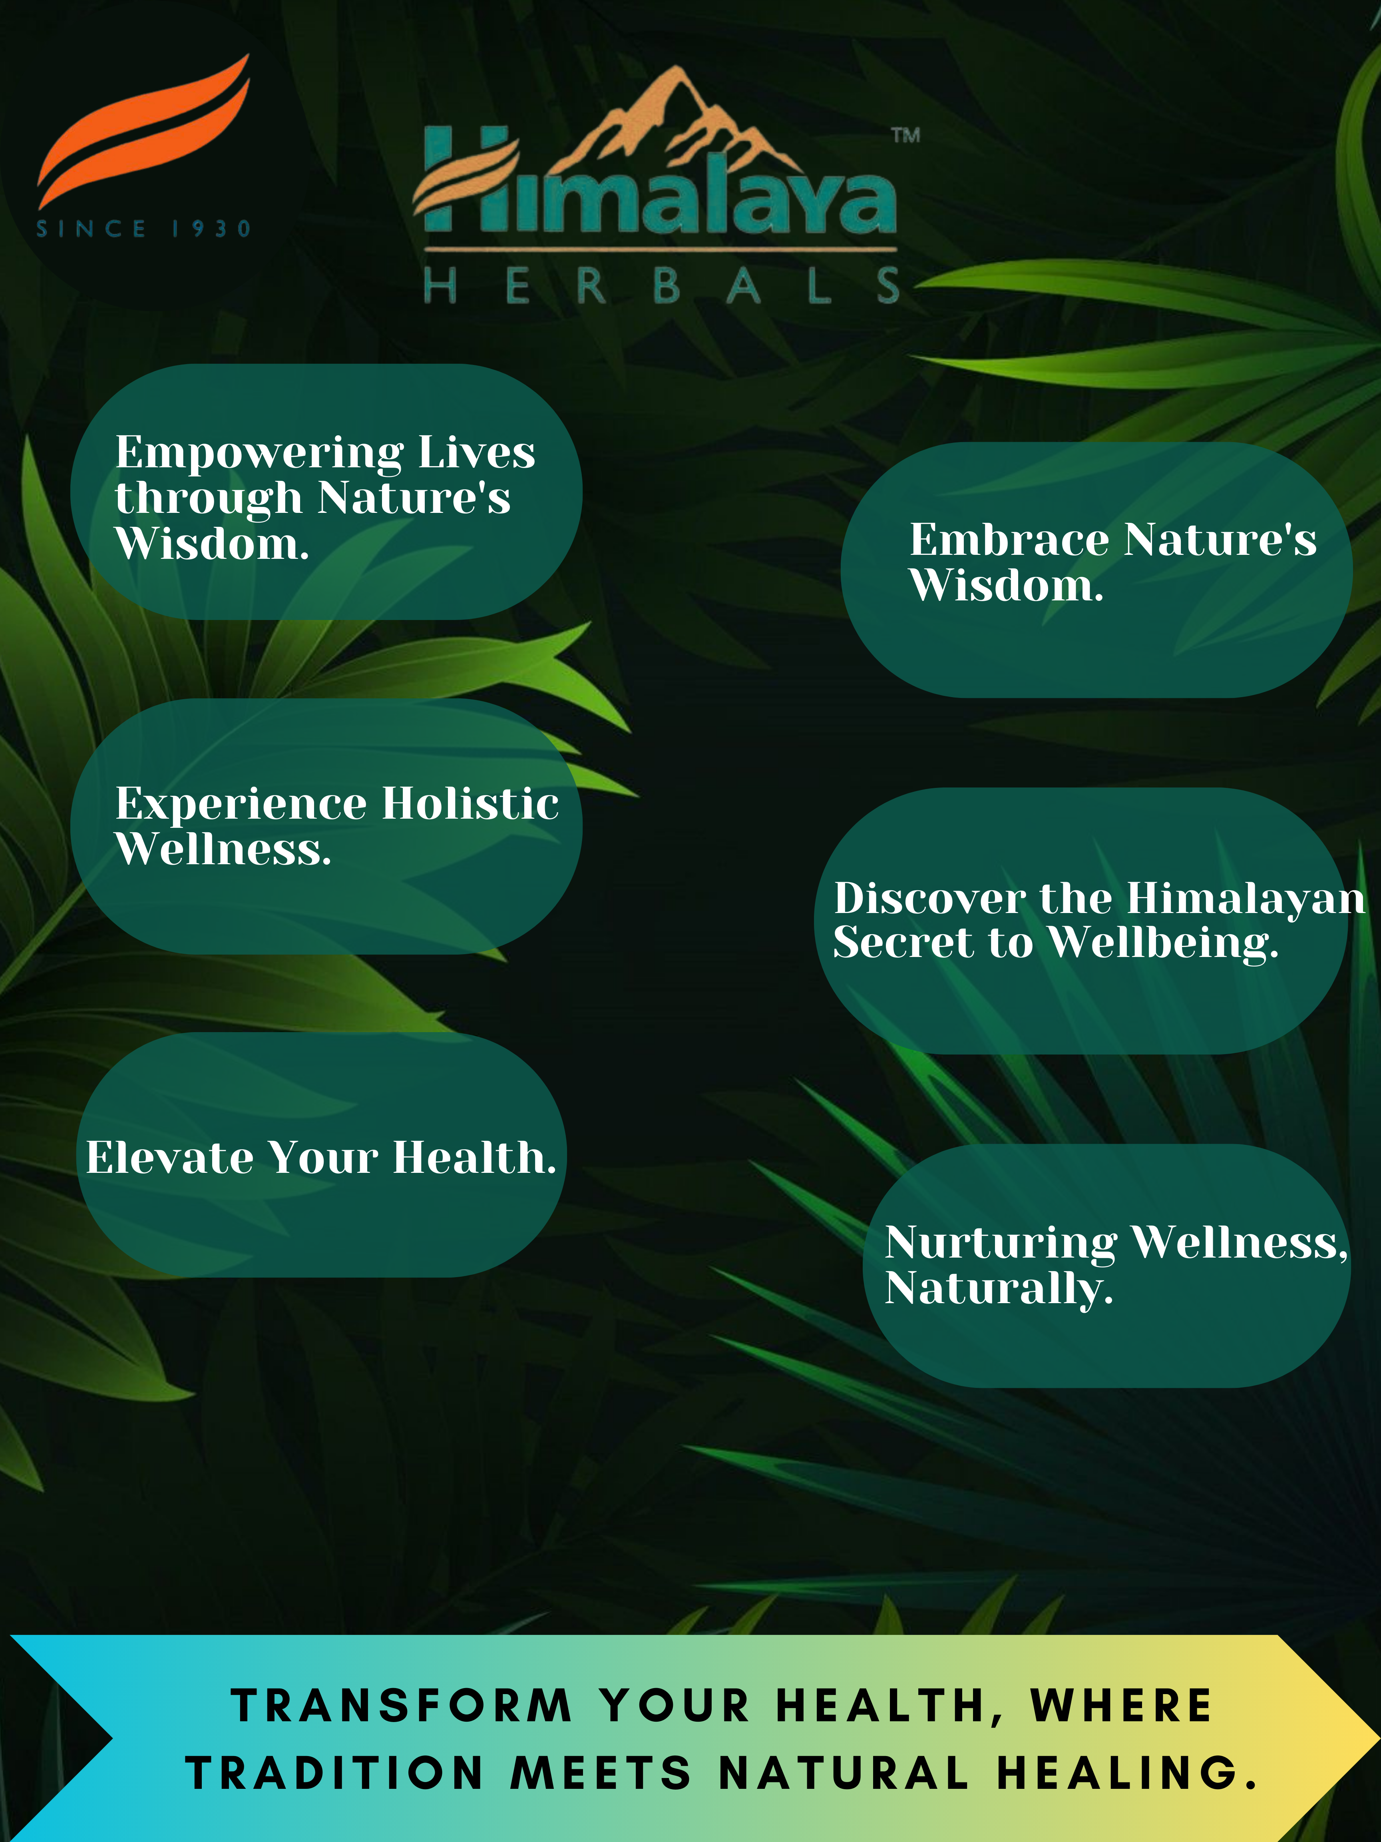
POST CREATIVE
DATE:- 03-08-2023
AIM :- It helps to understand the motto of the company.

Slide 62

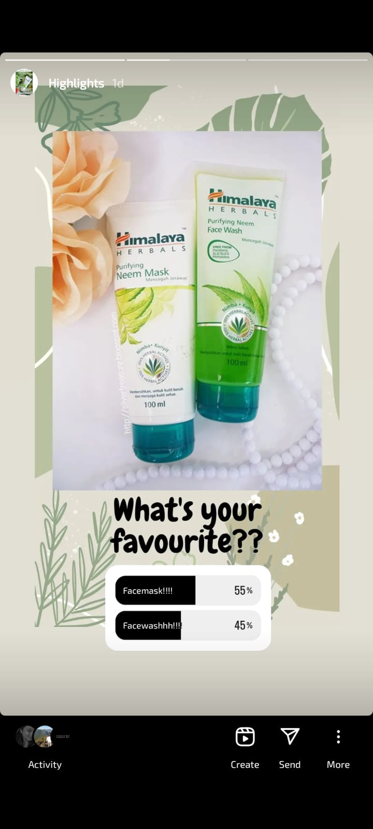
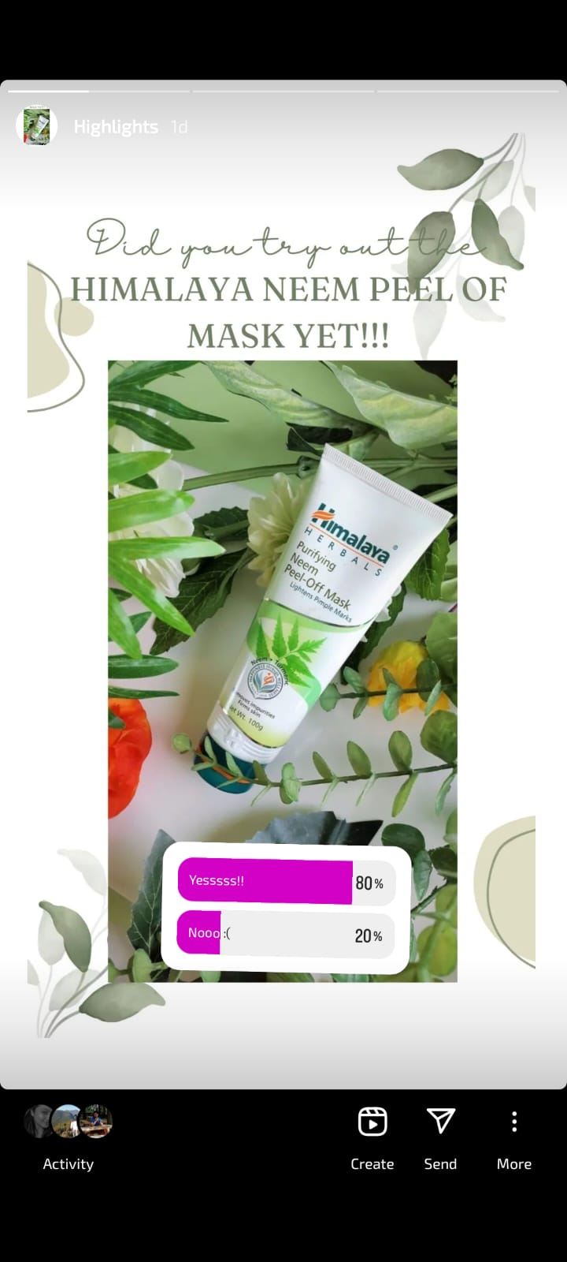
Instagram Story

Slide 63
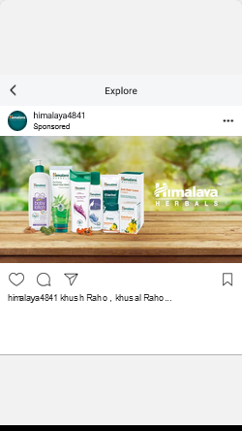
Social Media Ad Campaigns
BRAND AWARENESS
Targeting: location- India, all genders
Age-18-75
Health ,beauty, skincare ,
hair care ,natural skin care

Slide 64
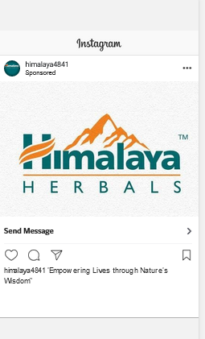
TRAFFIC:-
Targeting: location- India, all genders
Age-18-75
Health ,beauty, skincare ,
hair care ,natural skin care

Slide 65

GENERATING LEADS :-
Targeting: location- India, all genders
Age-18-75
Health ,beauty, skincare ,
hair care ,natural skin care

Slide 66



Email Ad Campaigns

Slide 67




Slide 68
Part 4: Content Creation and Curation (Post creations, Designs/Video
Editing, Ad Campaigns over Social Media and Email Ideation and Creation)
Reflect on the content creation and curation process, discussing the challenges faced and lessons learned.
Content creation and curation are crucial aspects of any brand's marketing strategy, and for Himalaya Herbals, a well-known herbal healthcare and personal care brand, it would be no exception. The process involves creating valuable, informative, and engaging content to connect with their target audience and build brand loyalty. Let's discuss the challenges faced and lessons learned in the content creation and curation process for Himalaya Herbals:
Challenges Faced:
Authenticity and Credibility: As a herbal healthcare brand, Himalaya Herbals must prioritize authenticity and credibility in their content. They may face challenges in ensuring that all the information provided is backed by scientific research and aligns with their product claims. Balancing traditional herbal knowledge with modern research can be complex but is essential for gaining consumers' trust.

Slide 69
Educating the Audience: Herbal healthcare may require educating the audience about the benefits and usage of herbal ingredients. Convincing consumers to switch from conventional products to herbal alternatives might be a hurdle, especially if there's a lack of awareness about the efficacy of herbal remedies.
Competing in a Saturated Market: The herbal healthcare market is often crowded with various brands offering similar products. Standing out and differentiating their content from competitors' might be a challenge for Himalaya Herbals.
Regulatory Compliance: Health and wellness brands like Himalaya Herbals must adhere to strict regulations regarding product claims and advertising. Ensuring that all content complies with these regulations can be time-consuming and may limit their ability to communicate certain benefits.
Content Consistency: Maintaining a consistent and coherent brand voice across all platforms can be challenging, especially when dealing with different content types like blog articles, social media posts, videos, and more.

Slide 70
Lessons Learned:
Research-Backed Content: Himalaya Herbals should prioritize conducting thorough research and relying on scientific evidence when creating content. This will help establish the brand's credibility and foster trust among consumers.
Storytelling and Education: Utilizing storytelling techniques can make educational content more engaging and relatable. Sharing success stories and experiences of real users can create an emotional connection with the audience.
Focus on Niche Topics: Instead of trying to cover a broad range of topics, Himalaya Herbals can focus on niche areas within herbal healthcare where they can establish themselves as experts. This can help them stand out in the market and attract a more targeted audience.
Collaboration with Influencers: Partnering with influencers who align with their brand values can help Himalaya Herbals reach a wider audience and gain credibility through word-of-mouth marketing.

Slide 71
User-Generated Content: Encouraging customers to share their experiences and testimonials can provide a valuable source of user-generated content. It can also enhance brand loyalty and encourage others to try Himalaya Herbals' products.
Consistency and Planning: Developing a content calendar and maintaining consistency in posting can help in streamlining the content creation process. It ensures that content aligns with marketing goals and maintains the brand's voice.
Engagement and Feedback: Actively engaging with the audience and seeking feedback can provide insights into what content resonates best with consumers. This information can guide future content creation efforts.
In conclusion, content creation and curation present both challenges and opportunities for Himalaya Herbals. By focusing on authenticity, education, differentiation, and maintaining consistency, the brand can successfully navigate the content landscape, build trust with their audience, and establish themselves as a reputable name in the herbal healthcare industry

